Slide 1
SECURE DATA HIDING IN IMAGES USING STEGANOGRAPHY
Presented By:R V S PAVAN KUMAR POTNURU Student Name : R V S PAVAN KUMAR POTNURU
College Name : Raghu Institute of Technology Department : ECE

Slide 2
OUTLINE
Problem Statement
Technology used
Wow factor
End users
Result
Conclusion
Git-hub Link
Future scope

Slide 3
PROBLEM STATEMENT
Older encryption methods are outdated due to predictable encryption patterns.
Encrypting data in images adds a layer of security to access or extract the hidden information.
Ensuring data security while maintaining the integrity of the cover image.
Making encryption and decryption techniques easier for non-technical users by using simple interface.

Slide 4
TECHNOLOGY USED
Programming Language : Python
Library : Opencv
Platform : Windows 11.
Minimum RAM : 4GB
File Handling : Basic encryption logic for password protection.

Slide 5
WOW FACTORS
Uses steganography to embed a message into an image without noticeable changes.
Data hiding using pixel value manipulation instead of outdated techniques.
Works on any image file format(PNG,JPG,etc.,)
Mainly, using recent algorithms like AES,RSA.

Slide 6
END USERS
Government & Defense : Secure message without raising suspiscion.
Journalists : Concealing sensitive information in images to avoid suspicion.
Banking Sectors : Secure important transaction details to protect from breaches.
Cybersecurity Enthusiasts : To learn more secure communication techniques.

Slide 7
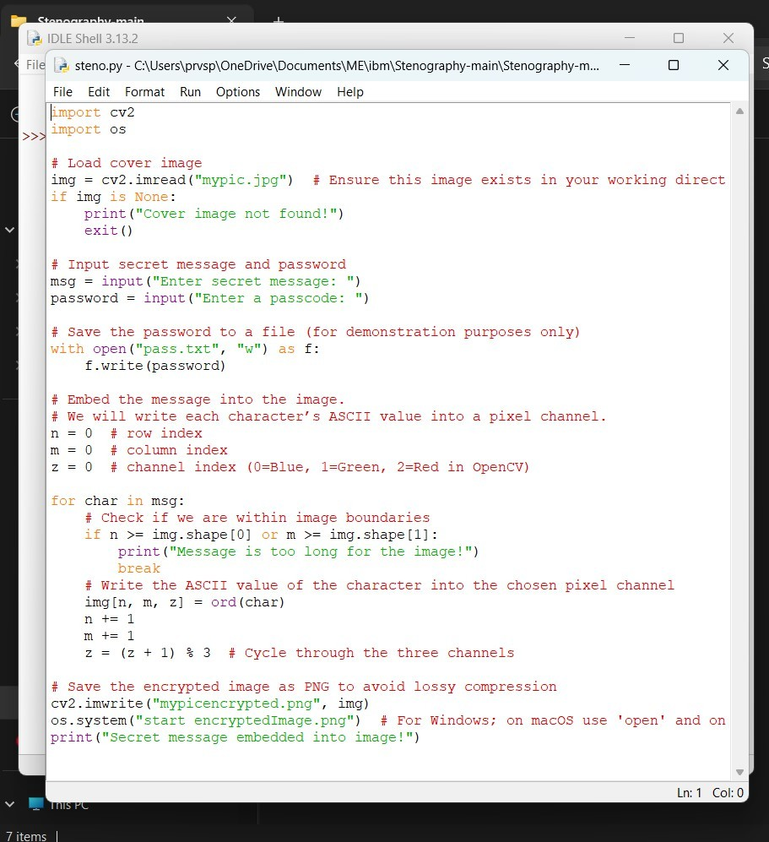
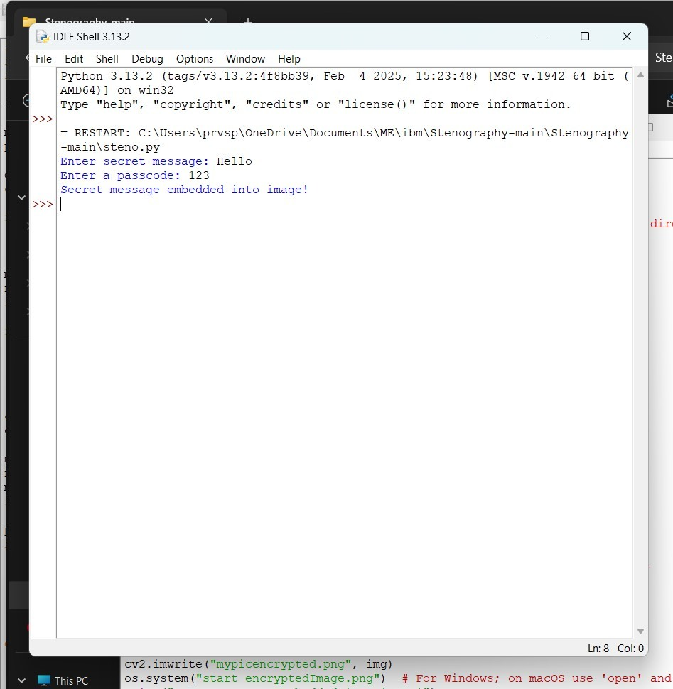

RESULTS
Encryption code:
Input image:

Slide 8
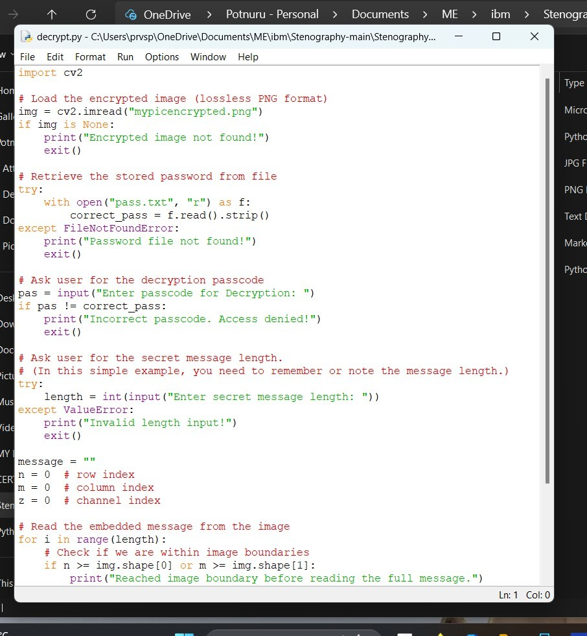
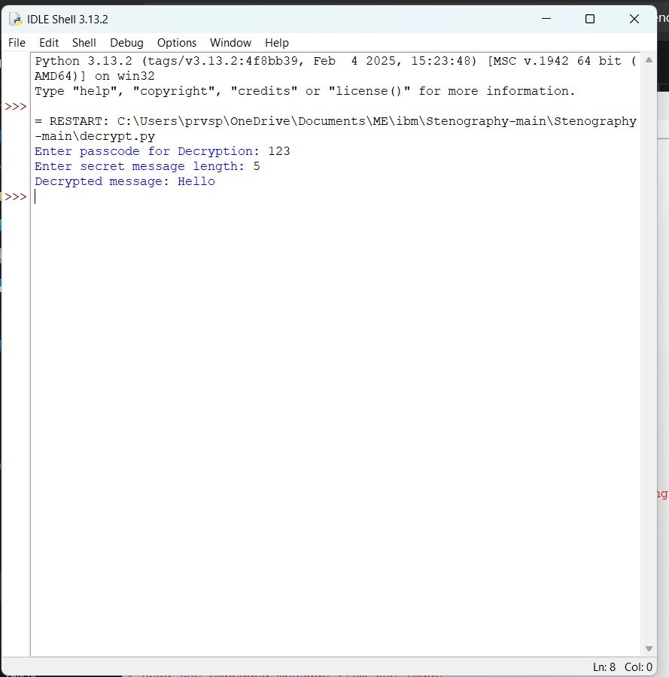

RESULTS
Decryption code:
Output image:

Slide 9
CONCLUSION
Steganography provides a unique way of communicating sensitive information.
This project showcases a simple yet effective implementation of message hiding in images.
This encryption and decryption technique is accessible even to non-technical users.
Future improvements can make it more robust,secure and scalable.

Slide 10
GITHUB LINK
https://github.com/prvspk/Stegnography.git

Slide 11
THANK YOU

